Slide 1
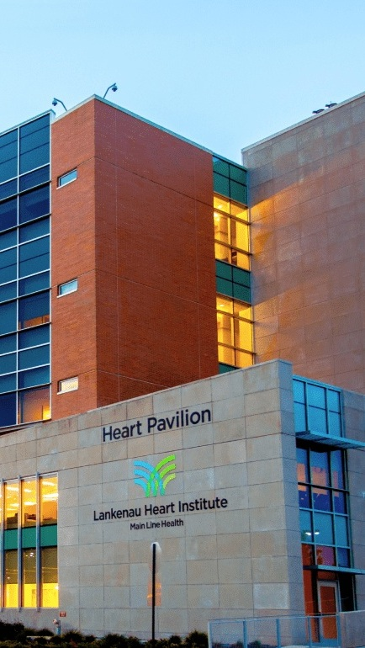


OPPORTUNITY REVIEW
DIRECT-TO-EMPLOYER GTM STRATEGY
Exploring a Main Line Health DTE Health Plan

Slide 2


Founded in 1979, headquartered in Indianapolis
Largest Independently-Owned Full-Service Third-Party Administrator
Specialize in Administration of Self-Funded Plans and Population Health Management​
Leader in the Direct-to-Employer Movement
We Know and Understand the Market
Experience Working with All Professional Teams: Agents, Networks, MGAs
The Key Family of Companies is a Vertically Integrated group of benefit related organizations
3,000+ Corporate Clients
3 Million Members under Management
700 Employees

Slide 3
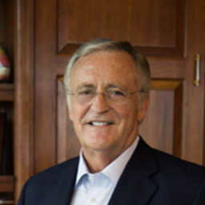

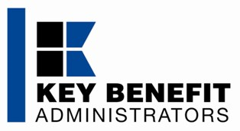
Our Founding and Heritage: 46 Years of Striving for Honesty in Healthcare

Slide 4
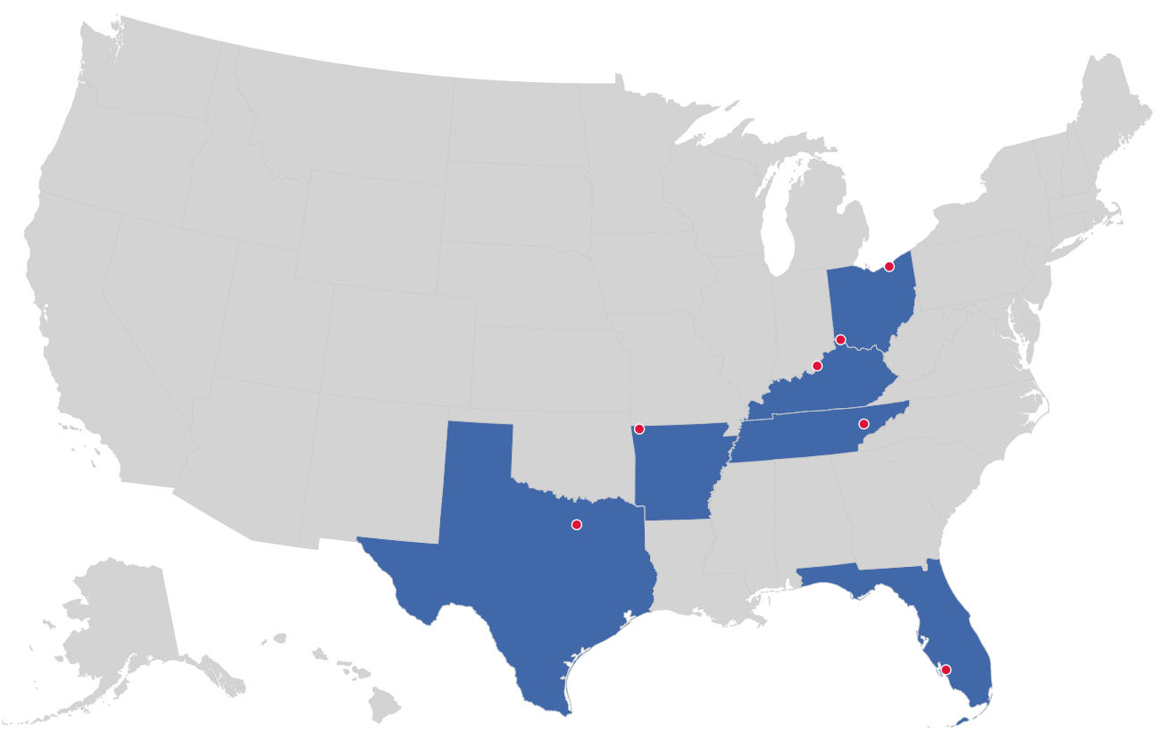

MARKET LEADER
IN
PRIVATE LABELED
DTE PLANS
Cleveland, OH
Louisville, KY
Cincinnati, OH
Bentonville, AR
Knoxville, TN
Dallas Fort Worth, TX
Fort Myers, FL

Slide 5
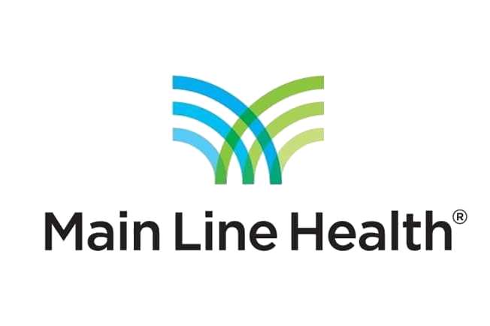

DIRECT-TO-EMPLOYER (DTE)
YOU Pick the Name of the Health Plan
YOU Determine the Fees Charged
YOU Practice the Medicine
YOU Receive the Profits
WE Make it Successful
Your Health Plan Focused on a Direct Relationship with Self-Funded Employers in Your Market

Slide 6
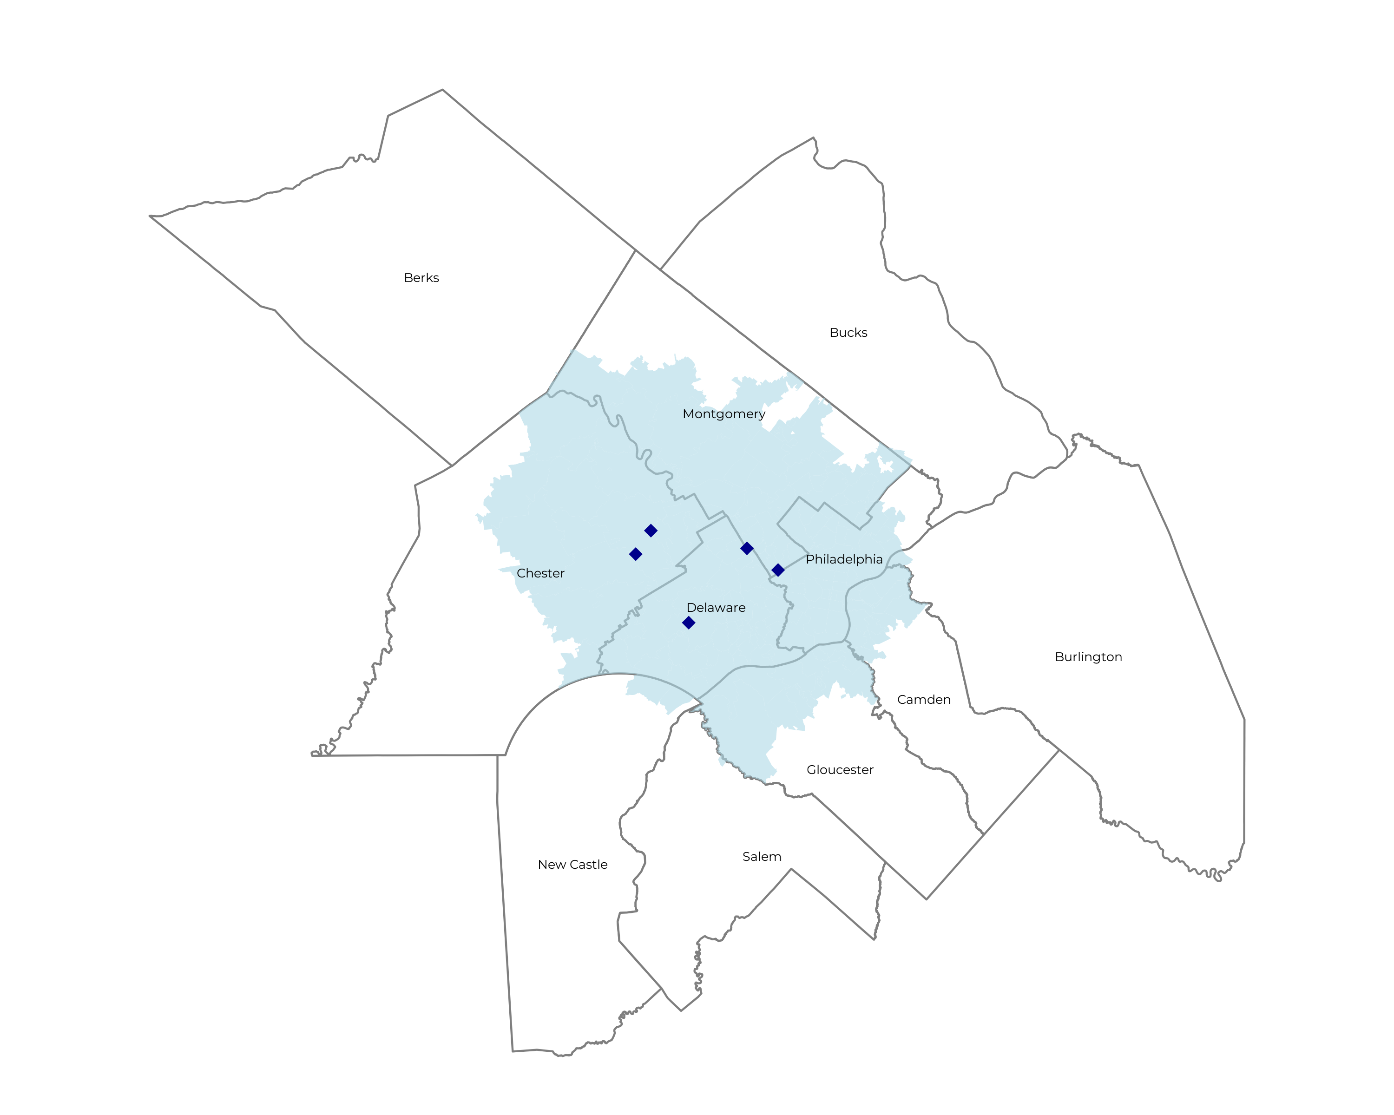
SIGNIFICANT OPPORTUNITY FOR PLAN GROWTH Researched for the below highlighted service area
Target Market 5,000+ Employers 1.2M+ Employees 1.9M+ Members
 | Employer Size Group (# of Employees)
Commercial Employers With Headquarters | 50-100 | 101-200 | 201-400 | 401-1,000 | 1,001-3,000 | 3,000+
In Catchment Area | 2,652 | 1,114 | 737 | 448 | 167 | 129
Total Employees at Employers | 50-100 | 101-200 | 201-400 | 401-1,000 | 1,001-3,000 | 3,000+
Headquartered in Catchment Area | 198,900 | 167,100 | 221,100 | 313,600 | 334,000 | 774,000
Total Members with Employers | 50-100 | 101-200 | 201-400 | 401-1,000 | 1,001-3,000 | 3,000+
Headquartered in Catchment Area | 358,000 | 300,800 | 398,000 | 564,500 | 601,200 | 1,393,200

Slide 7
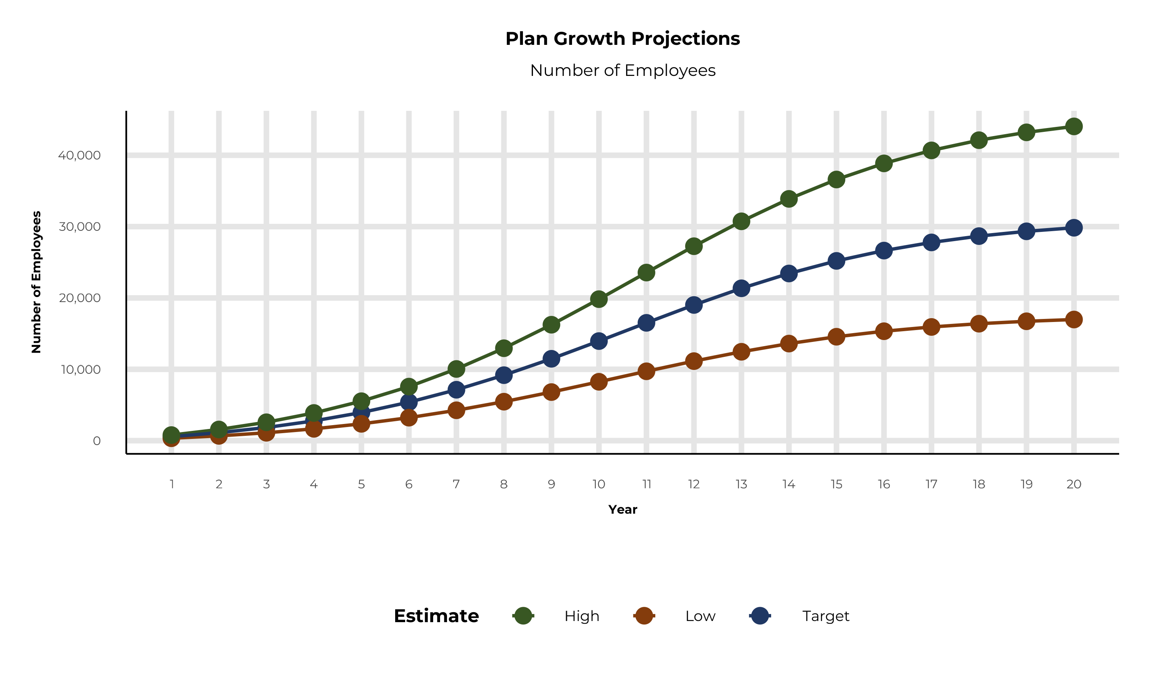
PLAN POTENTIAL GROWTH PATHS
Self Funded
818K
Insured
1,413K
Working Age
1,994K
Population
3,296K
Estimates includes the Main Line Health service area in New Castle, Burlington, Camden, Gloucester, Chester, Delaware, Montgomery, and Philadelphia Counties

Slide 8
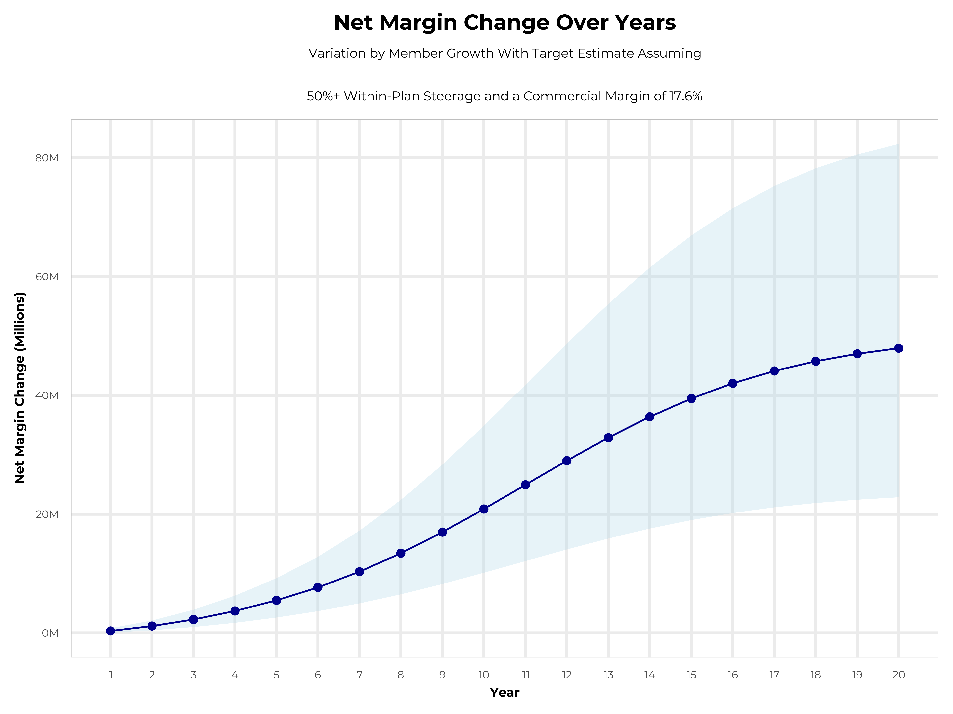
GROWING POWERFUL, LASTING PROFITABILITY
Early Stage
Gaining Name Recognition, Early Growth
New Revenue:
New Profit:
$20.4M
$3.45M
Growth Stage
Strong Reputation, Strong Growth
New Revenue:
New Profit:
$119.59M
$21.21M
Mature Stage
High Profitability, Market Saturation
New Revenue:
New Profit:
$242.98M
$43.24M

Slide 9
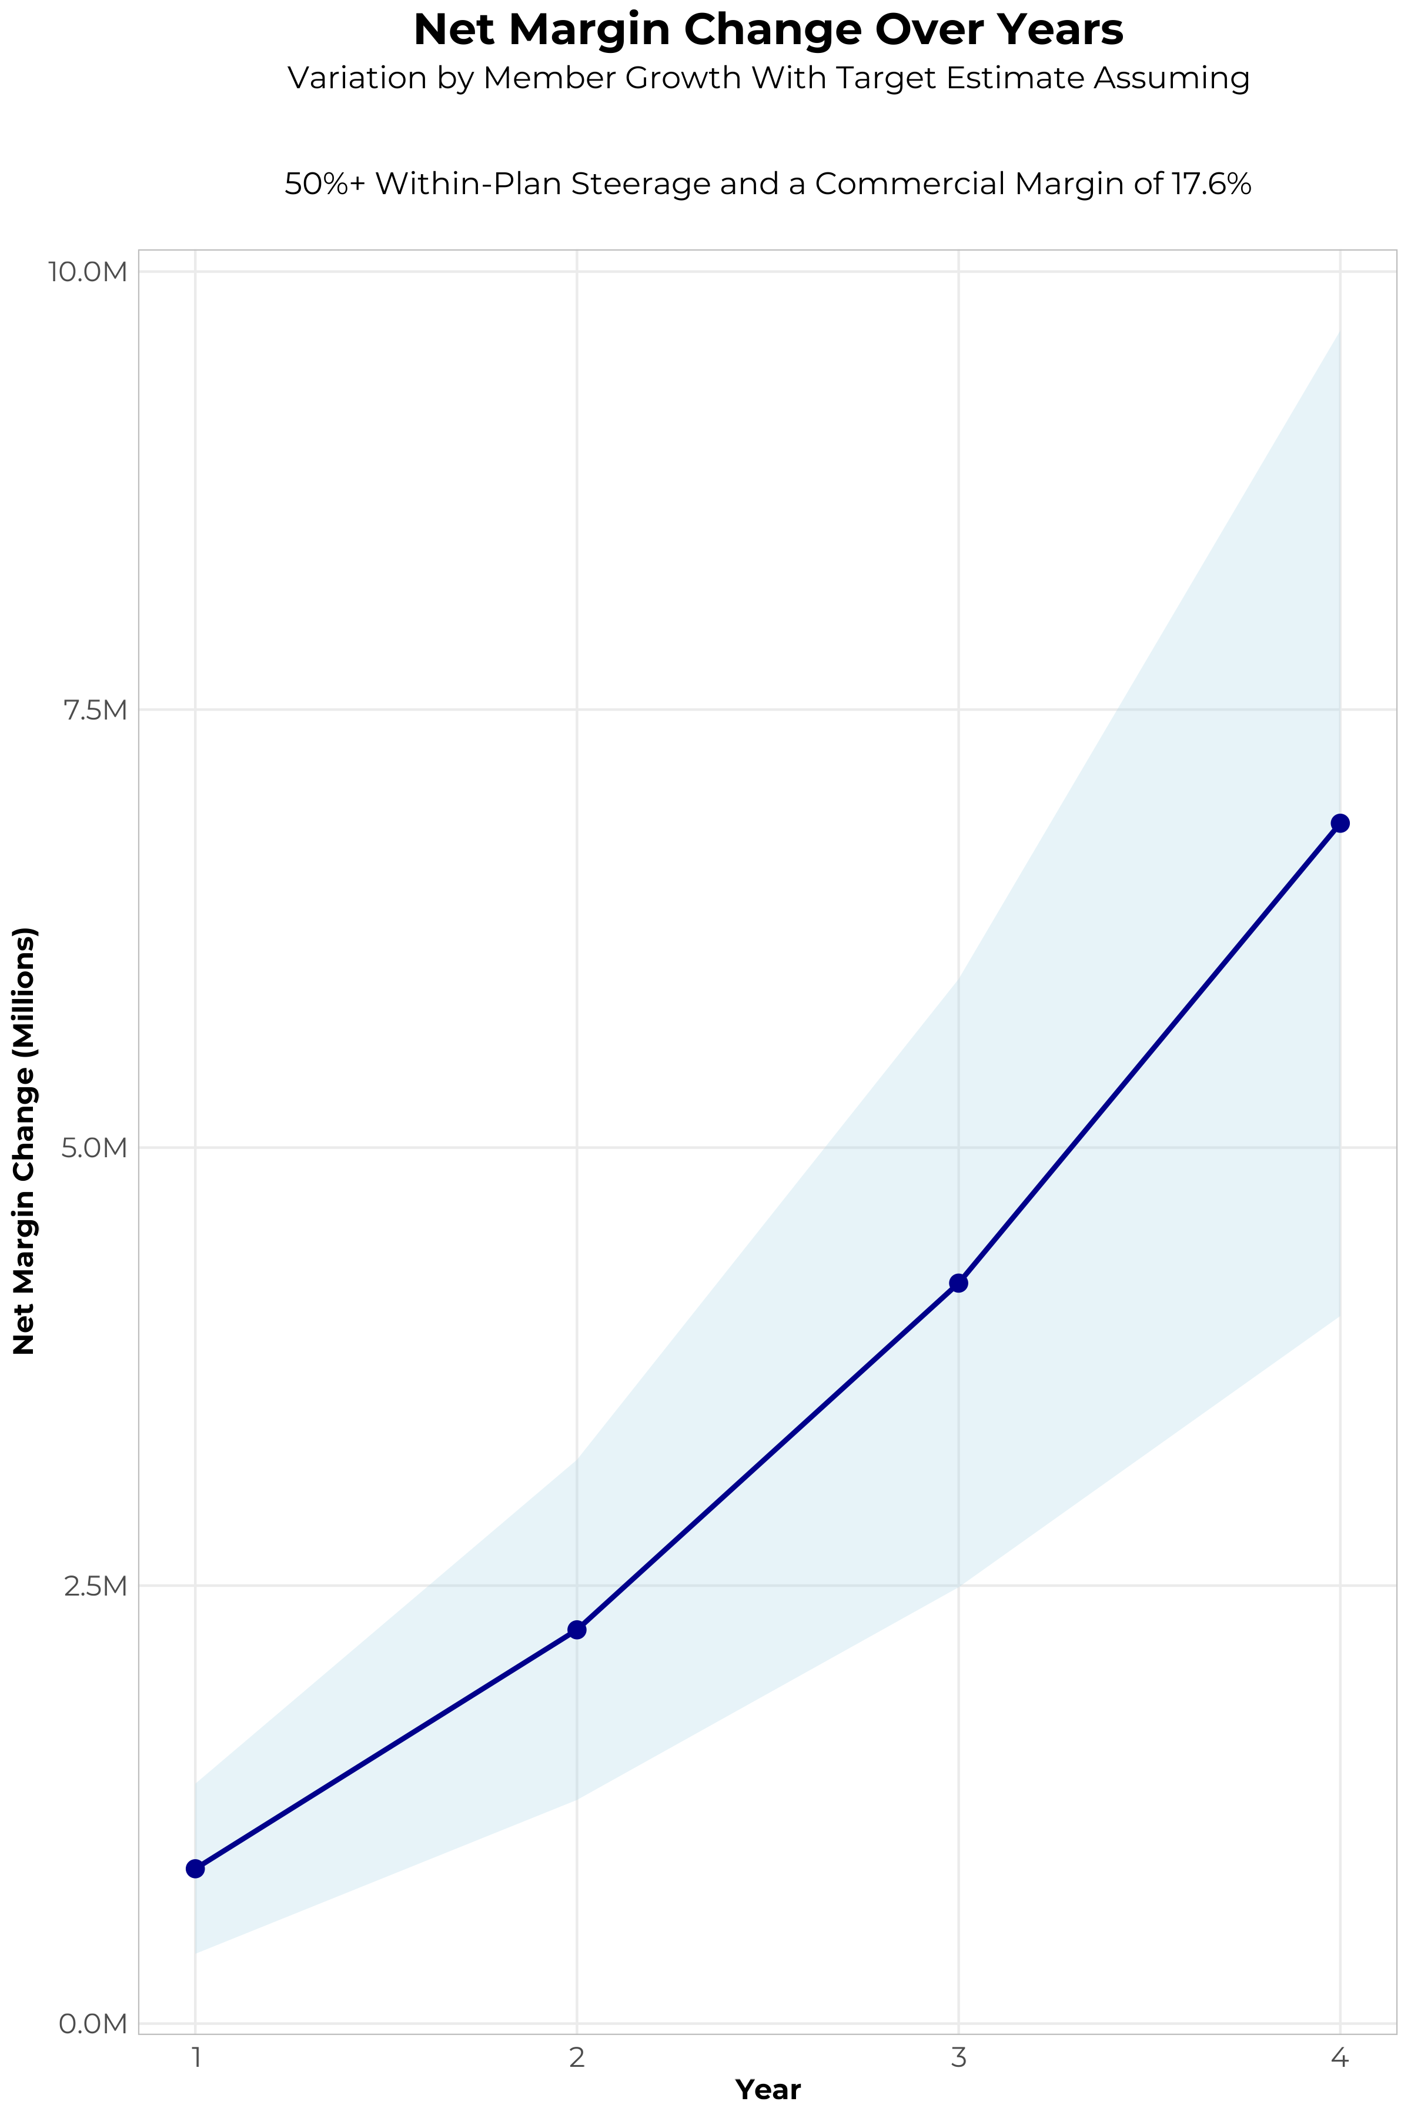
FOUR-YEAR PROJECTIONS
Target Member Growth | Target Member Growth | Target Member Growth | Target Member Growth | Target Member Growth
Metric | Year 1 | Year 2 | Year 3 | Year 4
Number of Members | 1,000 | 2,000 | 3,300 | 5,000
Incremental Margin | 1,201.8K | 2,403.5K | 4,366.8K | 6,971.3K
Network Access Fee | 12.0K | 24.0K | 39.6K | 60.0K
Implementation Fee (One-Time) | -150.0K | 0.0K | 0.0K | 0.0K
Sales and Marketing Costs | -180.0K | -180.0K | -180.0K | -180.0K
Net Margin Change | 883.8K | 2,247.5K | 4,226.4K | 6,851.3K
High Member Growth | High Member Growth | High Member Growth | High Member Growth | High Member Growth
Metric | Year 1 | Year 2 | Year 3 | Year 4
Number of Members | 1,400 | 2,800 | 4,600 | 7,000
Incremental Margin | 1,682.5K | 3,364.9K | 6,087.0K | 9,759.9K
Network Access Fee | 16.8K | 33.6K | 55.2K | 84.0K
Implementation Fee (One-Time) | -150.0K | 0.0K | 0.0K | 0.0K
Sales and Marketing Costs | -180.0K | -180.0K | -180.0K | -180.0K
Net Margin Change | 1,369.3K | 3,218.5K | 5,962.2K | 9,663.9K
Low Member Growth | Low Member Growth | Low Member Growth | Low Member Growth | Low Member Growth
Metric | Year 1 | Year 2 | Year 3 | Year 4
Number of Members | 600 | 1,200 | 2,000 | 3,000
Incremental Margin | 721.1K | 1,442.1K | 2,646.5K | 4,182.8K
Network Access Fee | 7.2K | 14.4K | 24.0K | 36.0K
Implementation Fee (One-Time) | -150.0K | 0.0K | 0.0K | 0.0K
Sales and Marketing Costs | -180.0K | -180.0K | -180.0K | -180.0K
Net Margin Change | 398.3K | 1,276.5K | 2,490.5K | 4,038.8K

Slide 10
DIRECT-TO-EMPLOYER STRATEGY: ONLY AVAILABLE TO PREMIER HEALTH SYSTEMS
STRONG Brand Quality
EXTENSIVE Patient Access
AFFORDABLE Value Pricing
EXCELLENT Care Quality

Slide 11
MAIN LINE HEALTH IS PATIENT RECOMMENDED
Health System | HCAHPS Recommendation Percentile | CMS Stars Percentile | Mortality Percentile | Readmission Percentile | KBA Brand Quality Score
Other Independent Hospitals | 97 |  | 54 | 91 | 76
Penn Medicine | 84 | 96 | 81 | 61 | 73
Main Line Health | 78 | 87 | 80 | 59 | 71
Cooper University Health | 48 | 31 | 69 | 54 | 62
Redeemer Health | 41 | 31 | 76 | 58 | 59
Jefferson Health | 29 | 39 | 77 | 46 | 54
Department of Veterans Affairs | 31 | 97 | 75 | 72 | 54
Virtua Health | 21 | 31 | 66 | 47 | 52
Tower Health | 16 | 44 | 63 | 52 | 51
Temple University Health System | 18 | 58 | 66 | 59 | 51
Trinity Health | 16 | 41 | 69 | 58 | 50
Prime Healthcare Services | 12 | 63 | 73 | 75 | 47
Based on quality measures and HCAHPS feedback, KBA estimates that Main Line Health has one of the the strongest brand qualities in New Castle, Burlington, Camden, Gloucester, Chester, Delaware, Montgomery, and Philadelphia Counties.

Slide 12
PROJECTED PLAN GROWTH
Year | Employees | Members | Percent of Members Choosing Main Line Health for Inpatient Care | Percent of Members Choosing Main Line Health for Outpatient Care
1 | 600 | 1,100 | 60% | 50%
2 | 1,100 | 2,000 | 60% | 50%
3 | 1,800 | 3,200 | 65% | 55%
4 | 2,800 | 5,000 | 67% | 58%
5 | 3,900 | 7,000 | 68% | 60%
6 | 5,400 | 9,700 | 68% | 60%
7 | 7,100 | 12,800 | 69% | 61%
8 | 9,200 | 16,600 | 69% | 62%
9 | 11,500 | 20,700 | 69% | 62%
10 | 14,000 | 25,200 | 70% | 63%
11 | 16,500 | 29,700 | 70% | 63%
12 | 19,000 | 34,200 | 70% | 64%
13 | 21,400 | 38,500 | 71% | 64%
14 | 23,400 | 42,100 | 71% | 65%
15 | 25,200 | 45,400 | 71% | 66%
16 | 26,600 | 47,900 | 72% | 66%
17 | 27,800 | 50,000 | 72% | 66%
18 | 28,700 | 51,700 | 72% | 67%
19 | 29,300 | 52,700 | 72% | 67%
20 | 29,800 | 53,600 | 72% | 67%
KBA currently estimates that Main Line Health has 9% inpatient market share, and 4% outpatient market compared to hospitals/clinics in the Main Line Health service area (see slide 8).
Based on previous DTE experience, KBA expects a significant bump in patient steerage to Main Line Health.
Additional steerage will occur from additional steerage patient benefits and the patient convenience card.
High estimates start nearly 10% higher than target with low estimates at 10% lower than target

Slide 13
YEAR 4 PROJECTED REVENUE AND PROFIT
Pre-DTE Cohort of 5,000 Employees | Inpatient | Outpatient | Professional | Total
Revenue† | $ 1,744,215 | $ 1,326,073 | $ 619,264.7 | $ 3,689,553
Net Income‡ | $ 306,981.9 | $ 233,388.8 | $ 108,990.6 | $ 649,361.3
† Assuming proportional revenues from market shares of 9% (inpatient) and 4% (outpatient)
‡ Conservatively assuming a commercial margin of 17.6% (80% of the estimated commercial margin)
With DTE | Inpatient | Outpatient | Professional | Total
Revenue⁰ | $ 13,013,812 | $ 20,412,275 | $ 9,532,359 | $ 42,958,446
Net Income* | $ 2,290,431 | $ 3,592,560 | $ 1,677,695 | $ 7,560,686
⁰ Assuming 67% inpatient and 58% market steerage based on KBA narrow network DTE experience (see previous slide)
* Conservatively assuming a commercial margin of 17.6%, with a 10 percentage-point reduction to reflect competitive-edge rates and a 10 percentage-point increase due to lower billing costs and higher patient responsibility collections because of the member convenience card.
Total Increase in Net Income | $ 6,911,325
Network Access Fee (Revenue) of $1 PMPM | $ 60,000
Total Profit Growth | $ 6,971,325
Minus Implementation Fee (One-Time) | -$ 0
Minus Sales and Marketing (Annual – Ongoing) | -$ 180,000
Total | $ 6,791,325

Slide 14

A PARTNER YOU CAN TRUST
OUR OBJECTIVES ARE ALIGNED
WE KNOW THE
MARKET
COMPLETELY TRANSPARENT
WE HAVE THE SOPHISTICATION AND INFRASTRUCTURE TO EFFECTIVELY COMPETE
Derek Moore, Senior Vice President – KBA
845-283-9973 * derek.moore@keybenefit.com

